Slide 1
DEFECT MANAGEMENT PROCESS

Slide 2
What is it?
Defect management can be defined as a process of detecting bugs and fixing them. The process of defect management, or bug tracking, is usually conducted at the stage of product testing.
The goals of the process include:
Prevent the defect
Early detection
Minimize the impact
Resolution of the defect
Process improvement

Slide 3
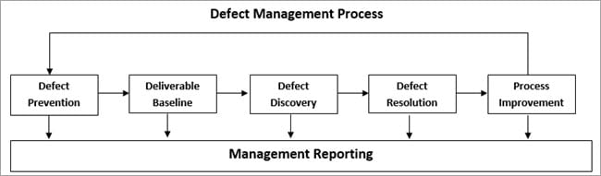
DEFECT PREVENTION
Identify critical risks
Estimate expected impact: For each critical risk, calculate how much would be the financial impact if the risk actually encountered.
Minimize expected impact: Take the topmost risks which may be harmful to the system if encountered and try to minimize or eliminate the risk. For risks which cannot be eliminated, it reduces the probability of occurrence and its financial impact.

Slide 4
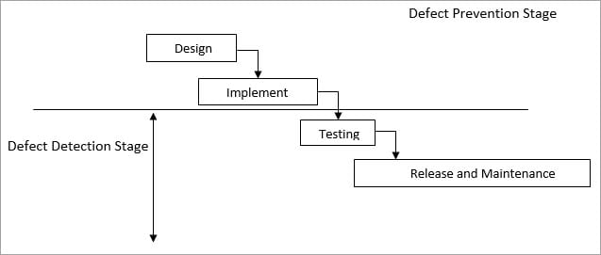
Defect Prevention Activities
Defect prevention activities are included in the project’s software development plan. Some of them are:
Task kick-off meetings
Casual analysis
Statistical methods

Slide 5
DELIVERABLE BASELINE
Project moves from one stage to another as a deliverable
Defects get carried forward
The deliverables are baselined when the changes in the deliverables are finalized and all possible defects are identified and fixed. Then the same deliverable passes on to the next group who will work on it.

Slide 6
DEFECT DISCOVERY
Find a defect: Identify defects before they become a major problem to the system.
Report defect: Make the development team aware that there is an issue identified which needs to be analysed and fixed.
Acknowledge defect: It’s the development team’s responsibility to acknowledge the defect and continue further to fix it if it is a valid defect.

Slide 7
DEFECT RESOLUTION
Resolve whether it is actually a defect or not
Prioritize risk: critical, high, medium, low
Fix defect: In order of importance.
Report the resolution: Testing team should be aware of all fixes.

Slide 8
PROCESS IMPROVEMENT
Attention to lower priority defects
Check the origin of defects

Slide 9
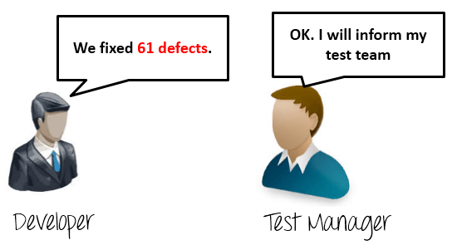
Management Reporting

